Slide 1
No/Low Code Development (LCD)
By Darshan A Nariya seat no: 2019031804 (E19110403000110036)

Slide 2
What is LCD?
No-code implies that no hand-coding is necessary.
Low-code implies use of elements that decrease amount of manual coding.
No clear understanding of LCD and its practices.
most developers tend to use low-code, drag and drop comes second, followed closely by visual programming.

Slide 3
Why LCD?
With the growth of the Internet and the wave of digitalization, there is a growing need for enterprises to make quick and resilient responses to changing market requirements.
According to Gartner, the demand for information systems will increase five times faster than the ability to provide them by IT departments, recruiting software engineers has become increasingly difficult as demand is high and supply is low.
To solve the problems above companies are looking for quicker and cheaper ways to meet their software needs. In response LCD platforms have emerged with the promise that organizations can hire business professionals with no coding experience to build applications.

Slide 4
Goal of LCD
The main goal of LCD as it suggests is to make development require less coding or less coding experience.
Enable to quickly assemble new processes and build applications without having to research, write, and test new scripts.

Slide 5
History of LCD
While the term “Low code development” is relatively new, the actual method it works is not that new.
Their roots trace back to Fourth-Generation Programming Language (4GL) , overlapping most of the development of 3GL.
3GL examples: C, C++, Java, JavaScript, VB
4GL examples: SQL, Python, Perl, PHP
4GL made programming relatively easy and more human readable, developer friendly.
So , any technology which made a tiresome task easy can be considered a step forward in Low Code Development.

Slide 6
Types of LCD
There is no standard definition for LCD in industry.
So, here I have divided them by the ‘Term’ it is used to explain its type accordingly.
Low Code
Drag and drop
Visual Programming
Pre-made Packages
WYSIWYG (What You See Is What You Get)
AI assist

Slide 7
1. Low Code
It is a visual approach to software development that optimizes the entire development process to accelerate delivery.
You can abstract and automate every step of the application lifecycle to streamline the deployment of a variety of solutions.
The term “Low code” is often used for solution that provide everything for developing an or S/W from start to the end like Creatio and Mendix.
Developers who want control don’t prefer them while it is great choice for non-developers with little to no knowledge of programming.

Slide 8
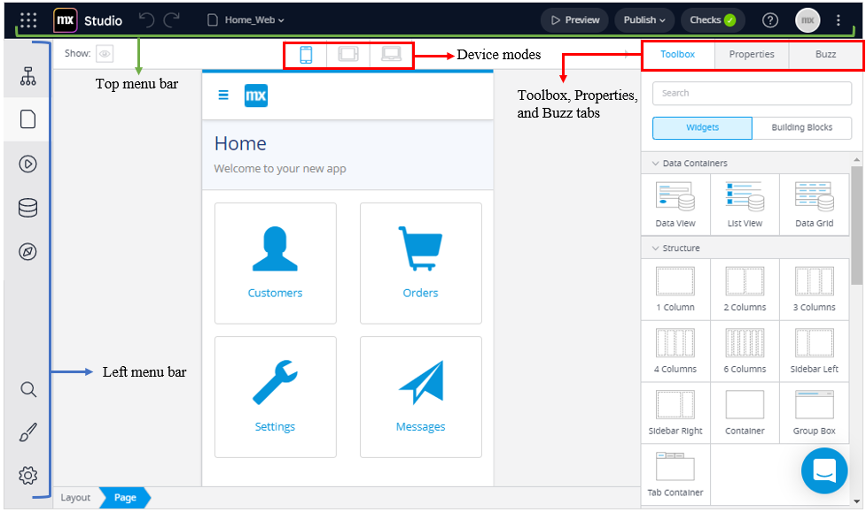

Slide 9
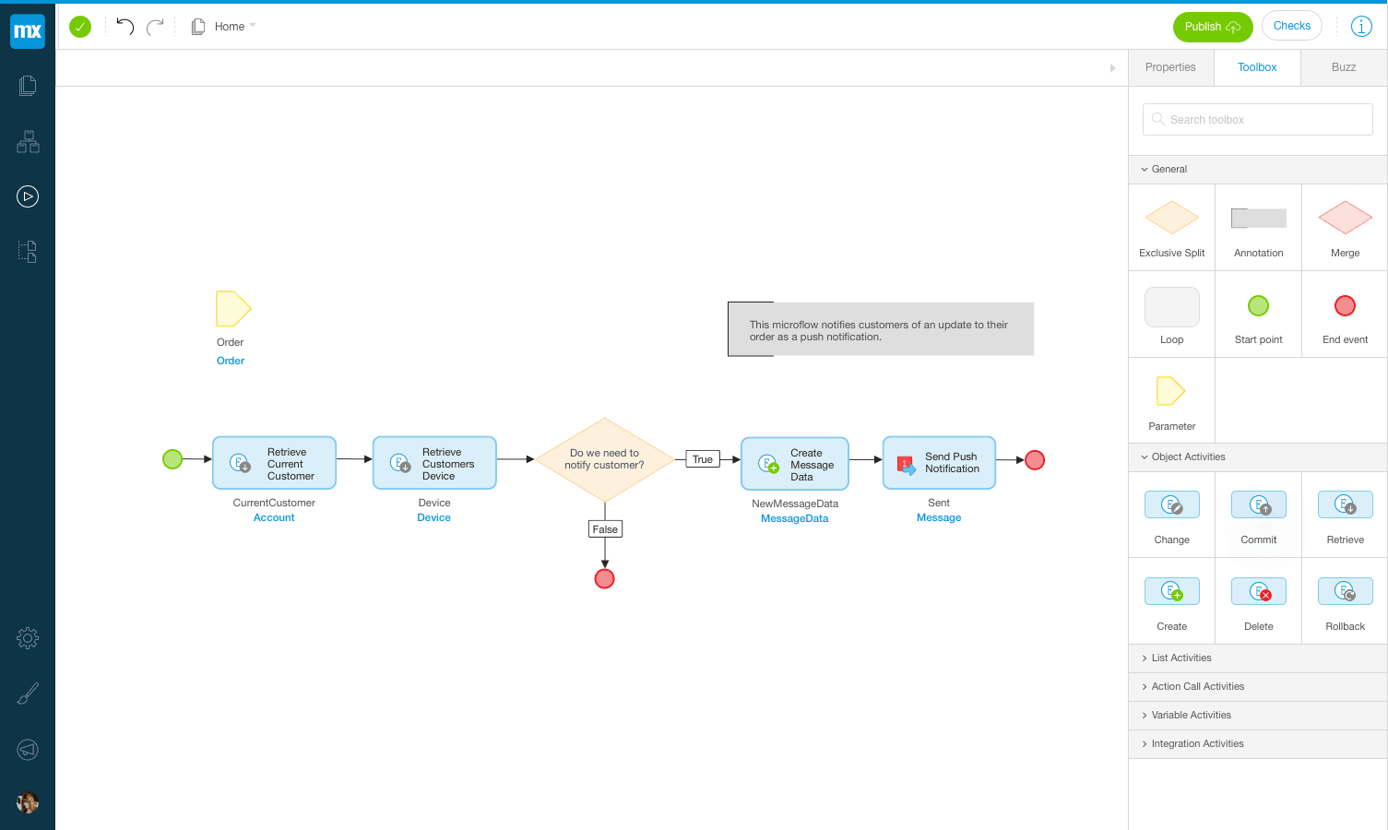

Slide 10
Pros & cons of low code
Pros
Cons
Low-code solutions provide all facilities needed for developing an app.
It is User Friendly.
No coding knowledge needed.
Not all solutions are open source.
User still have to be technical to understand workflow of Low-code.
It doesn’t provide control over all things.

Slide 11
2. Drag & drop
As it suggests is used for solutions that offer drag and drop feature to make applications.
Some solutions also provide drag and drop plus code for more flexibility.
It is extremely user-friendly cause user can just drop components and arrange them according to their liking, without coding a single line.
Many Website builders fall under this category like Wix.com, WordPress, Microweber and CMS hub etc.
There is also drag and drop plus code where custom code can be implemented with drag and drop components. Like Visual Studio, WordPress etc.

Slide 12
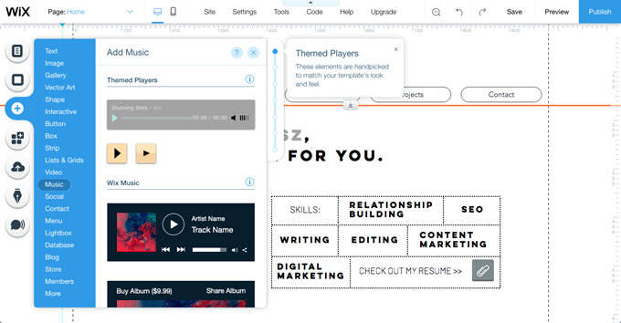

Slide 13
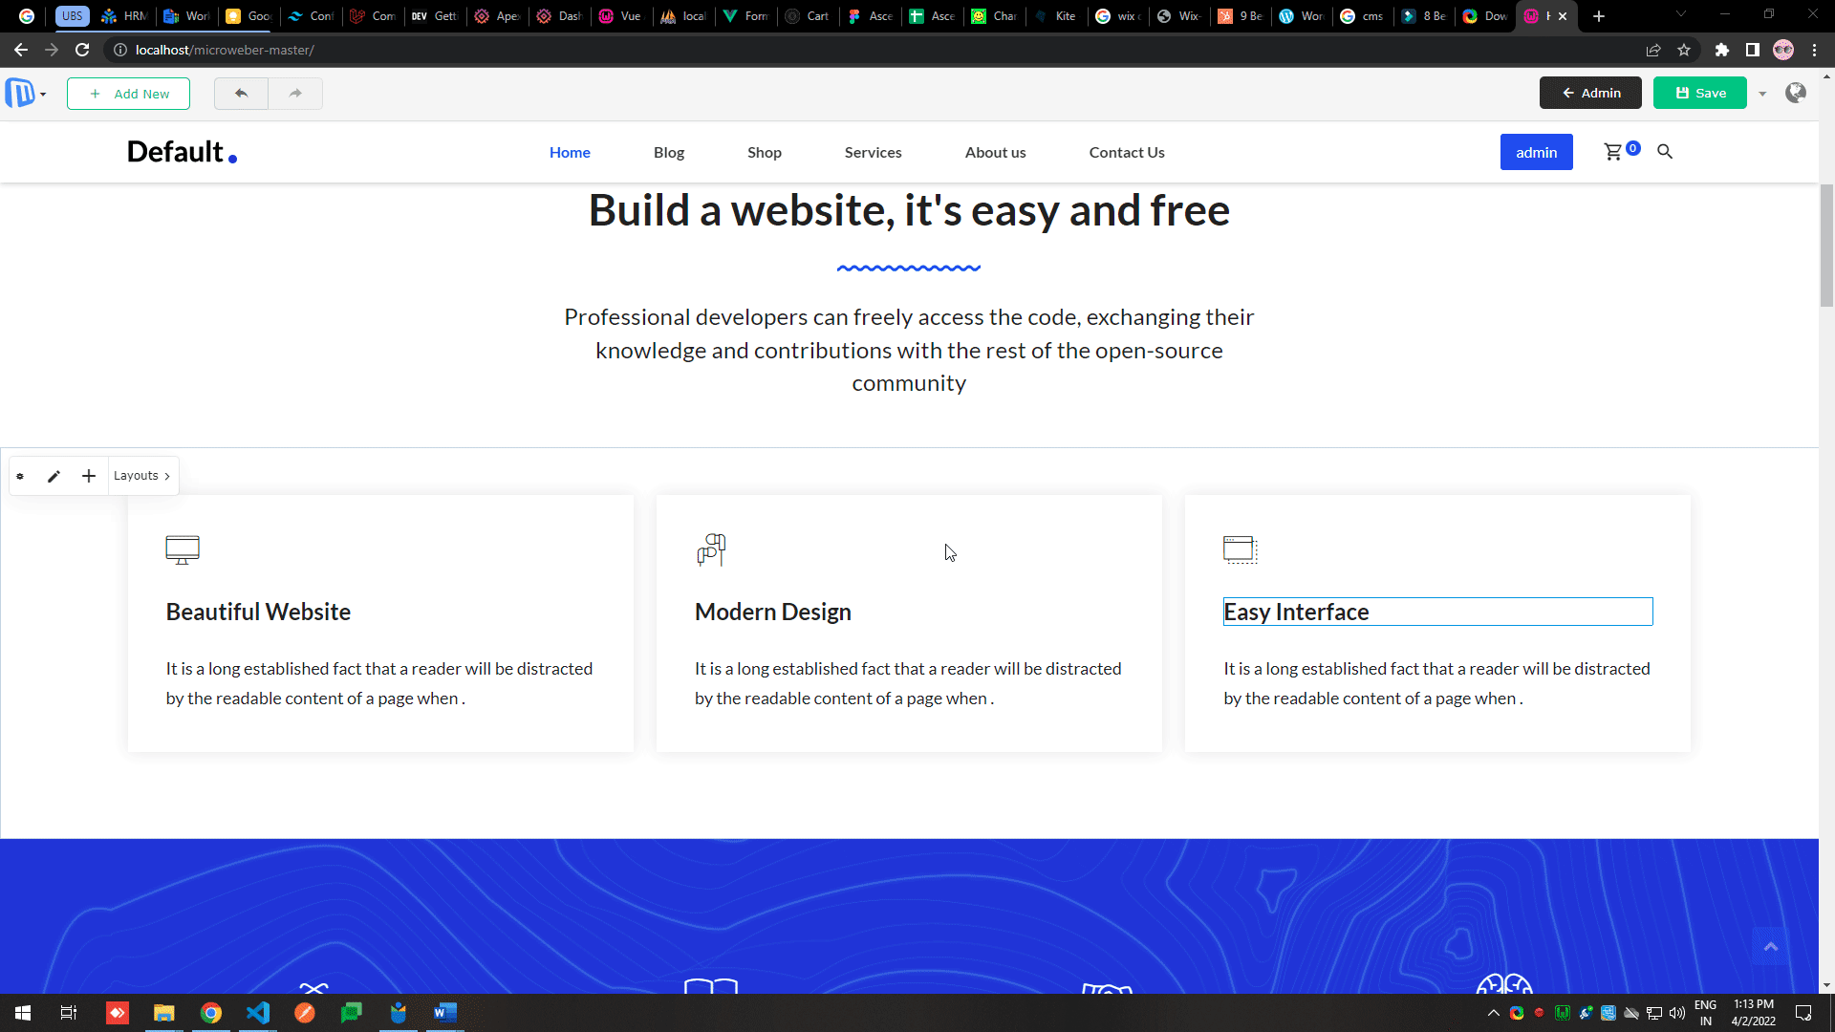

Slide 14
Pros & cons of drag & drop
Pros
Cons
Extremely user friendly.
With drag and drop plus coding it makes building apps very easy.
All platforms don’t provide custom coding functionality.
Most of solutions are commercial.

Slide 15
3. Visual Programming
It is used for visualized code where instead of blocks of code it is showed in parts of code is showed in form of building blocks or nodes.
You can change or add values inside these blocks manually.
It is beginner friendly and different from commonly used languages. like Scratch, Blockly etc.
Node based Visual Programming is widely used in 3d modelling and games studios like Unreal, blender, Unity.
Nodes based visual programming is difficult in its own and needs understanding to use but many people in community have made fabulous things out of it.

Slide 16
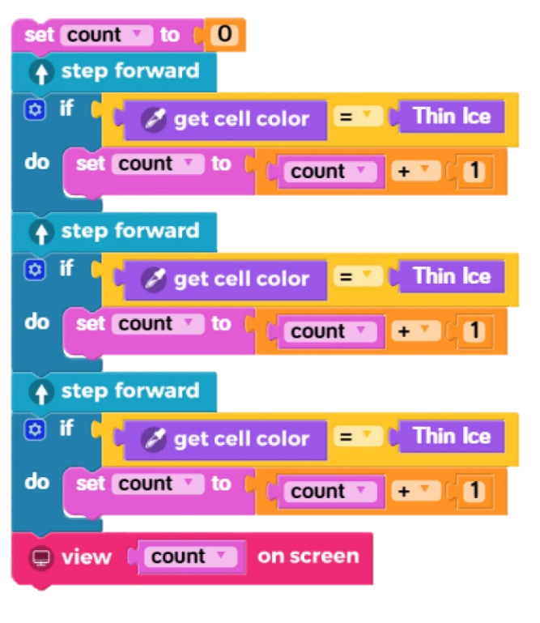
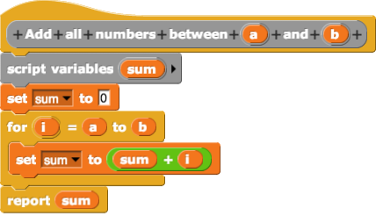

Slide 17
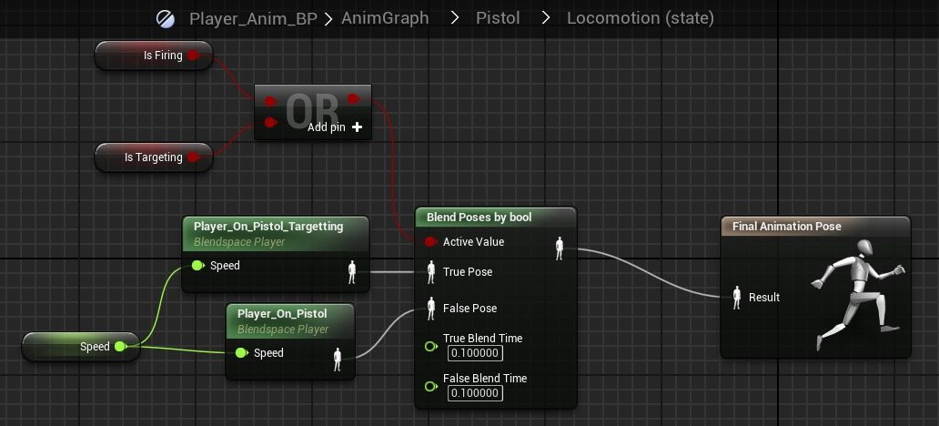

Slide 18
Pros & cons of visual prog.
Pros
Cons
Many Visual programming languages are easy to learn.
Languages provide many built-in objects that can be used to make applications.
While they are easy to learn they are hard to master.
After a point visual programming code becomes hard to manage.

Slide 19
4. Pre-made Packages
“Pre-made Packages” means using already made packages provided by community or solution provider.
These packages can be pre-installed or can be installed according to our need.
there are many open-source package managers in community like npm, composer yarn, etc.
Most of the time one package only provides few functionalities so we have to install multiple of them to full-fill our needs.
One still needs to have fair enough programming knowledge, but if one has the necessary knowledge packages makes so many things easy.

Slide 21
Pros & cons of pre-made packages
Pros
Cons
We don’t have to program every single feature.
There are many free and Open source packages available.
Package managers can be learning barrier to beginners.
Not all packages are trustable.

Slide 22
5. WYSIWYG
“WYSIWYG” stands for “What You See Is What You Get” .
It is type of system where user makes page like a word document and solution provides a web page based on what you entered, like Kompozer, Dreamweaver, etc.
Text editors used inside web browsers like CKEditor, summernote are very known example of this too.
It is relatively old now because in most cases it only provides tag formatted code, so it doesn’t complete whole job but it makes it easier.
It can still be seen in web solutions where user have to commonly change content there, we can use WYSIWYG Editor to make things easy.

Slide 23
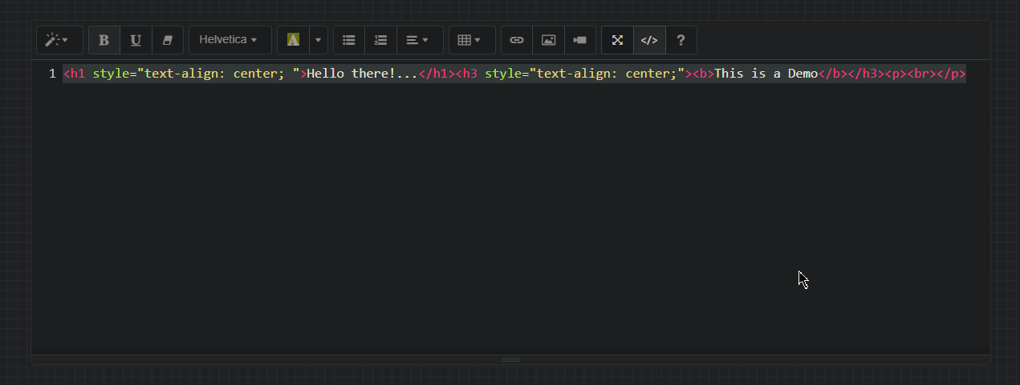

Slide 24
Pros & cons of wysiwyg
Pros
Cons
These are simple and easy to use.
These generate accurate code most of time only design problem occurs in old systems.
Implementing these in applications makes CMS easy.
Code generated by these can be bulky.
Not all editors follow W3C standard.

Slide 25
6. AI Assist
“AI Assist” means help of Artificial Intelligence to do coding instead of manual coding.
Before AI assist, we have seen code editors suggest code snippets while we write some common code, but they only suggest basic syntax.
AI assist doesn’t just suggest syntax it suggest entire blocks of functions based on what you have already written in your code.
There are many of these AI assist plugins out there like, GitHub co-pilot, Kite, JetBrains, etc.
here I have shown example of GitHub co-pilot.

Slide 27
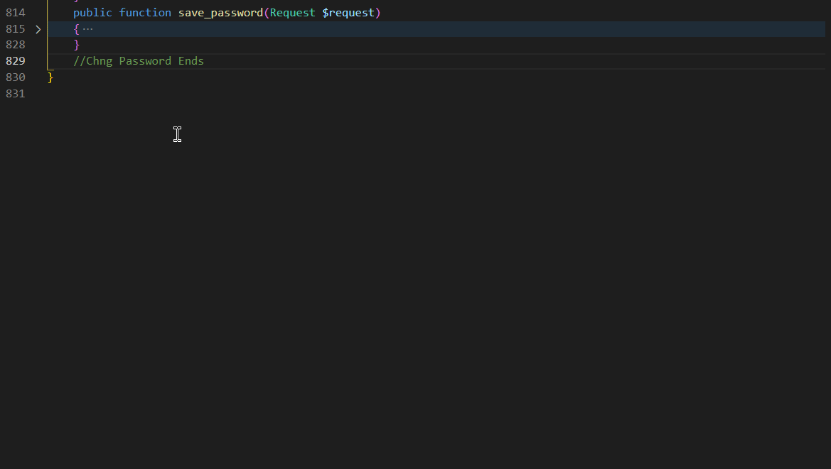

Slide 28
Pros & cons of ai assist
Pros
Cons
Helps suggesting entire blocks of code based on code you have written or name of your file and extension.
More you use more it becomes accurate.
It doesn’t suggest accurate code all the time.
You need programming knowledge to know what AI is suggesting.
These technologies are still in development.

Slide 29
Dis/advantages of LCD
Pros
Cons
Build applications faster with minimal effort.
Easier than programming.
Make apps without need of developers.
Newbie friendly.
Vendor lock-in.
Learning curve.
Expensive.
It limits experienced developers.
Limited and Inflexible.

Slide 30
Common uses In LCD
Common Application
Frontend is the most used part where LCD is used then comes backend in which APIs are most to build by LCD
Programming Languages
Java and JavaScript are both popular programming languages used.
Types of Applications
demand for developing mobile applications with low code is the highest among the types of applications.

Slide 31
Conclusion
LCD is not a new concept in software development, but recently is booming and gets much attention in industry that can help both developers and users quickly deliver applications by writing a few code.
Developers tend to describe LCD according to their understanding.
LCD platforms are easy to learn and speeds up the development.
Different LCD platforms support the development of different types and parts.
LCD is particularly favoured in the domains that have the need for automated processes and workflows.
They also suffer from no access of source code and vendor lock-in for commercial LCD platforms.

